Slide 1
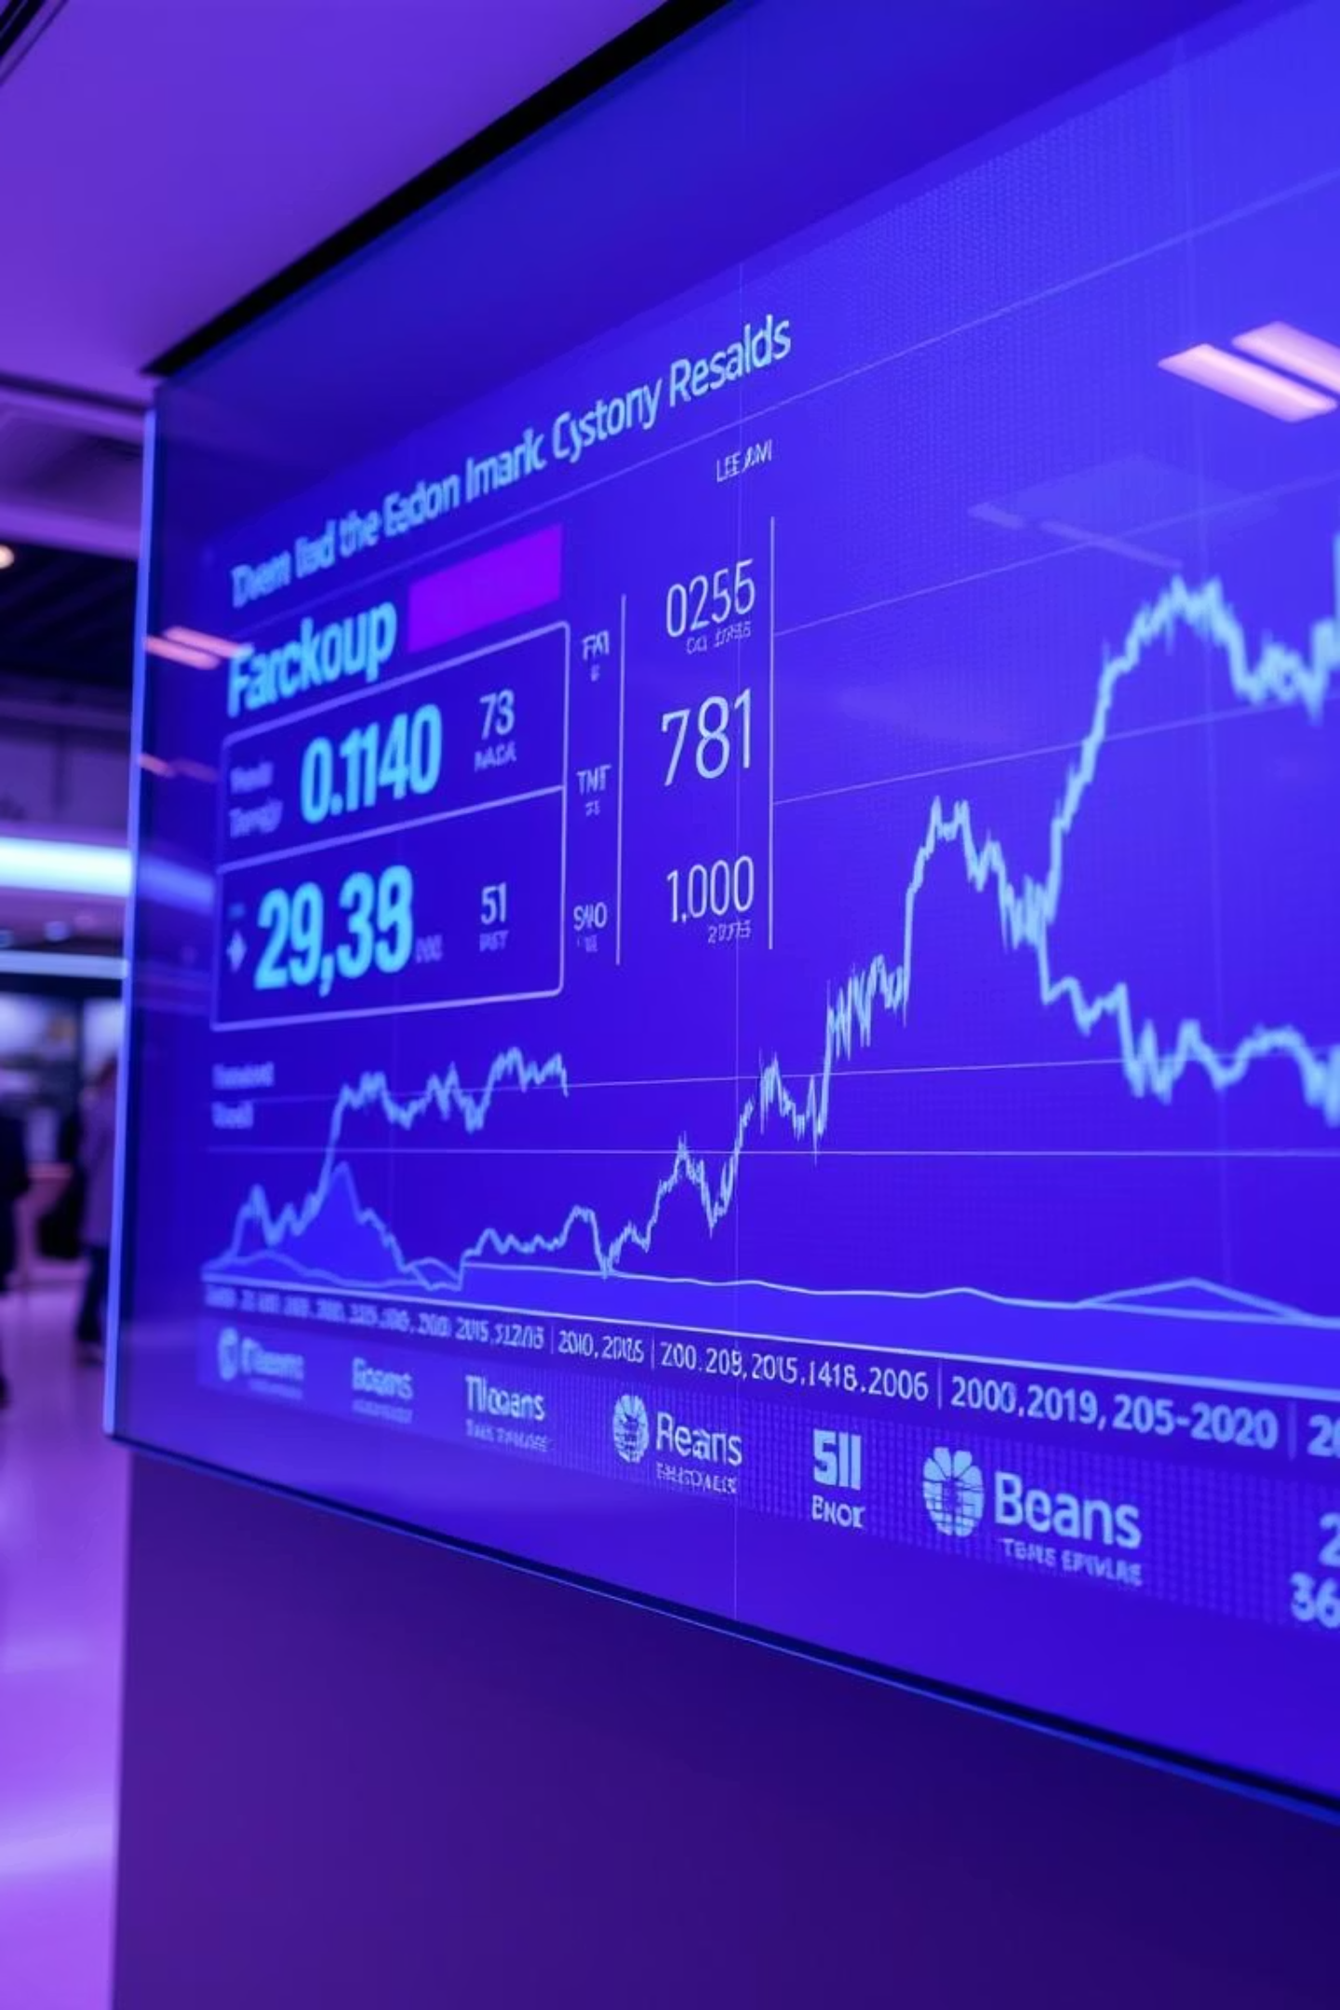
End-to-End Time Series Forecasting
Presented by: SheriF Shawky

Slide 2
Project Objectives: Forecasting Financial Time Series
Accurate Price Prediction
Diverse Model Application
Performance Comparison
Forecast the close price of a financial time series to gain market insights.
Rigorously compare the performance of each model to identify the most effective.
Apply and evaluate classical, machine learning, deep learning, and Prophet models.
Robust Model Deployment
Deploy the best-performing model using FastAPI and PyTorch for real-time predictions.

Slide 3
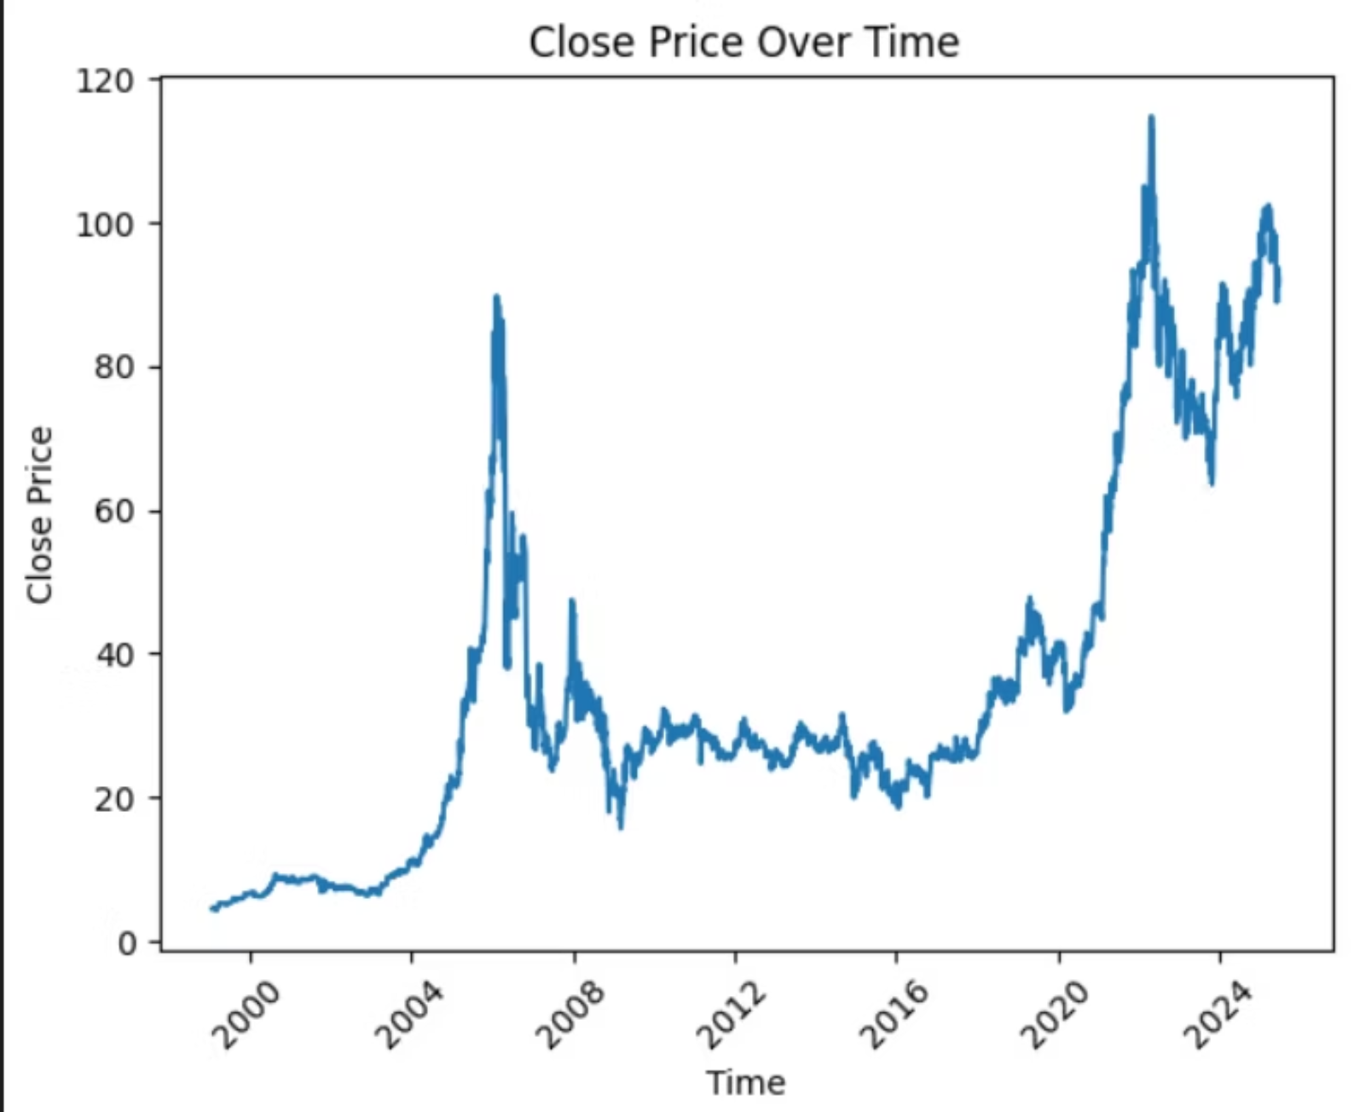
Data & Preprocessing: Setting the Foundation
Data Integration & Visualization
Combined training and testing CSVs, featuring over 14 time-series features. Dates were parsed, and initial trends were visualized to understand underlying patterns.
Stationarity & Feature Engineering
The Augmented Dickey-Fuller (ADF) test confirmed stationarity. We performed seasonal decomposition and engineered new features to enhance model input.

Slide 4
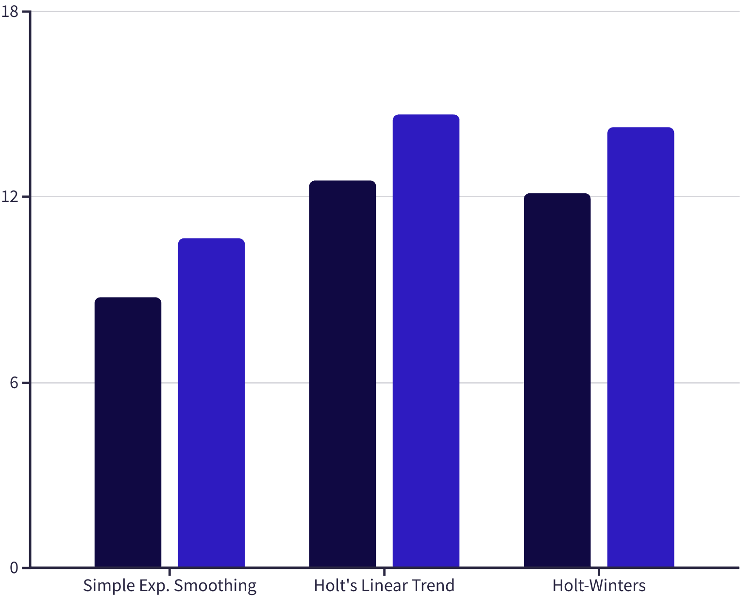

Classical Models: Initial Performance Benchmarks
Classical models like Simple Exponential Smoothing, Holt's Linear Trend, and Holt-Winters provided moderate performance. While effective for basic trends, they struggled with complex patterns in the financial time series.
This highlights the need for more sophisticated models to capture intricate data behaviors.
MAE
RMSE

Slide 5
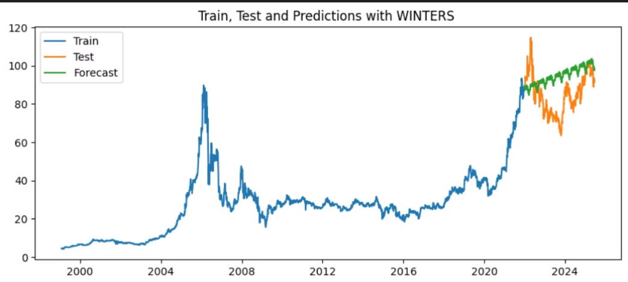
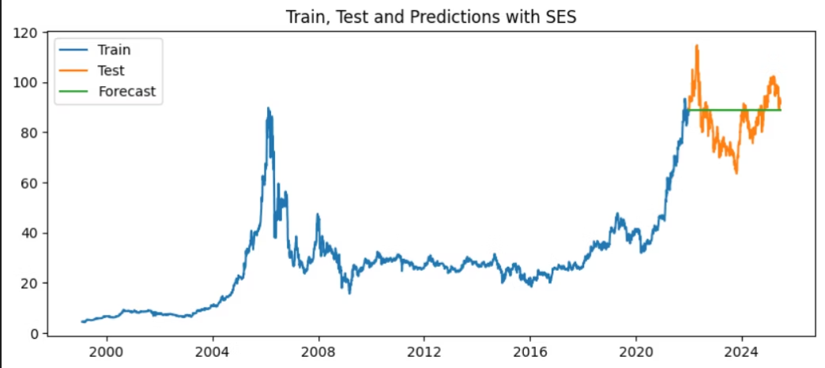

Exponential Moving Average

Slide 6
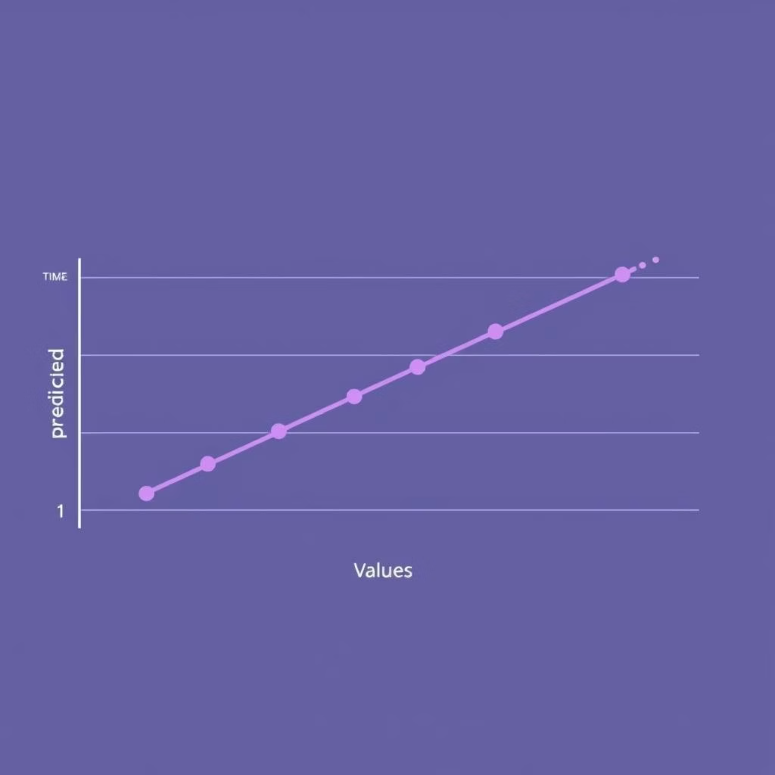
ARIMA Family Models: Capturing Dependencies
ARIMA/SARIMA vs. SARIMAX
ARIMA and SARIMA models showed moderate results (MAE=12.41, RMSE=14.52). However, SARIMAX significantly outperformed them with MAE=0.84, RMSE=1.17, and an impressive MAPE of 0.99%.
SARIMAX: The Breakthrough
SARIMAX's dramatic success is attributed to its ability to incorporate external regressors, capturing crucial dependencies that other models missed.

Slide 7
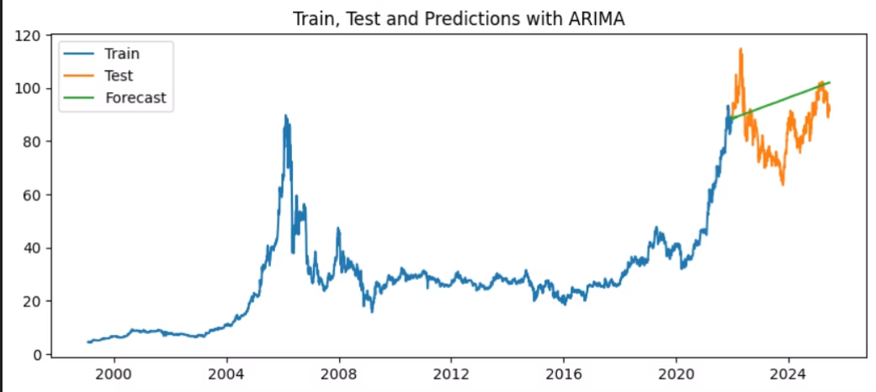
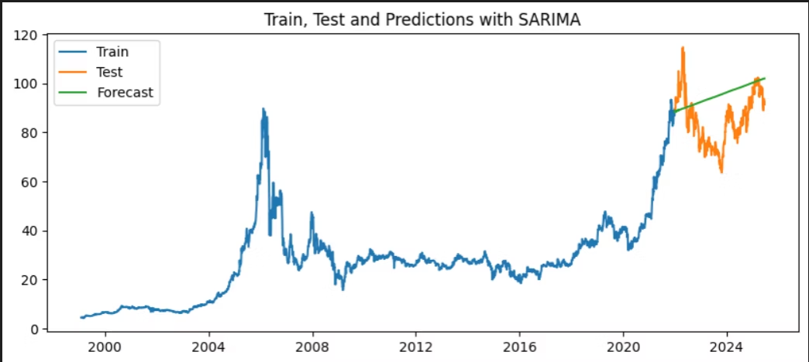
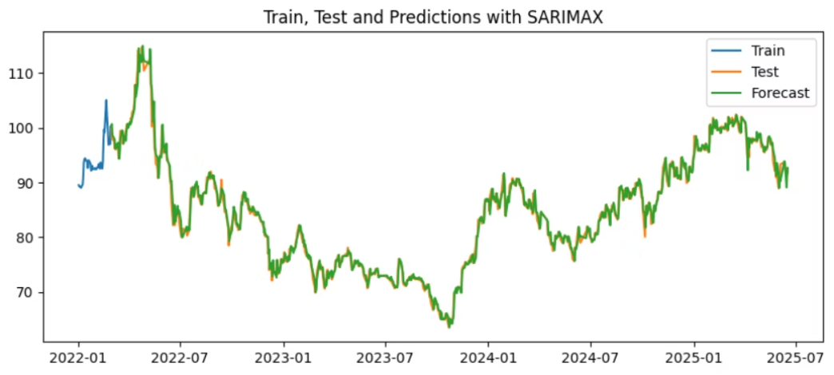
Arima

Slide 8
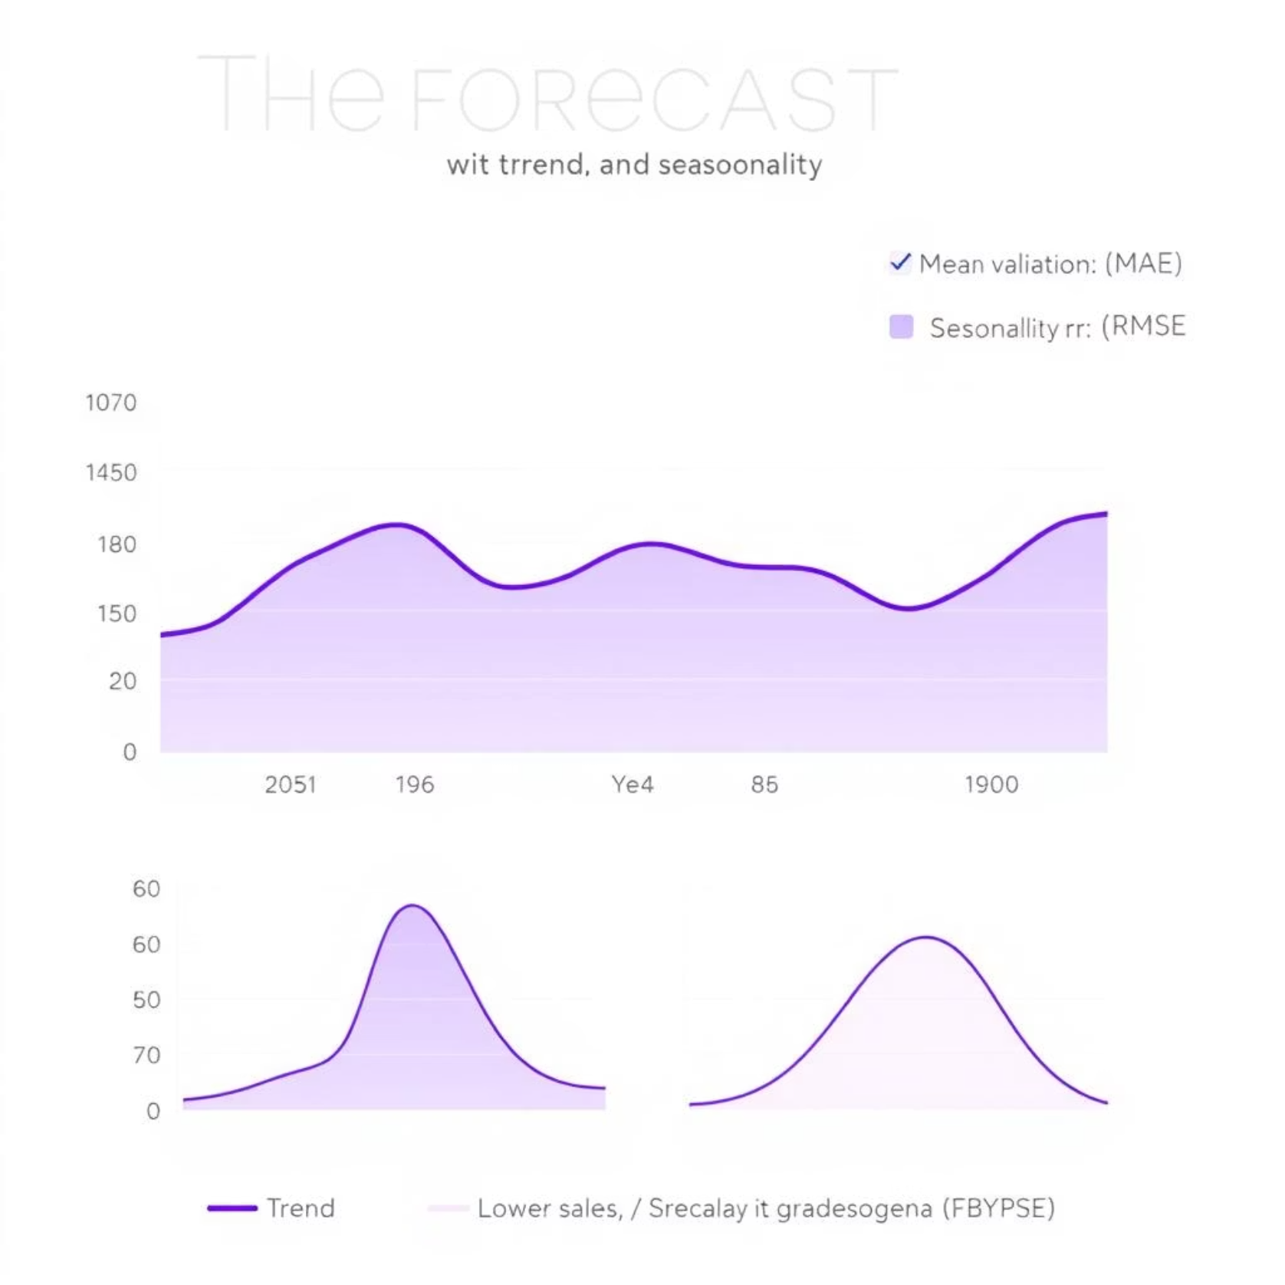
Prophet Forecasting: Simplicity and Interpretability
Prophet Model Configuration
Prophet, a forecasting tool developed by Facebook, was configured to model trends and seasonality automatically. The final RMSE achieved was 0.498.
Enhanced Predictions & Validation
The add_regressor() function was utilized to further enhance prediction accuracy by incorporating additional features. Rigorous rolling cross-validation was conducted to ensure model robustness.

Slide 9
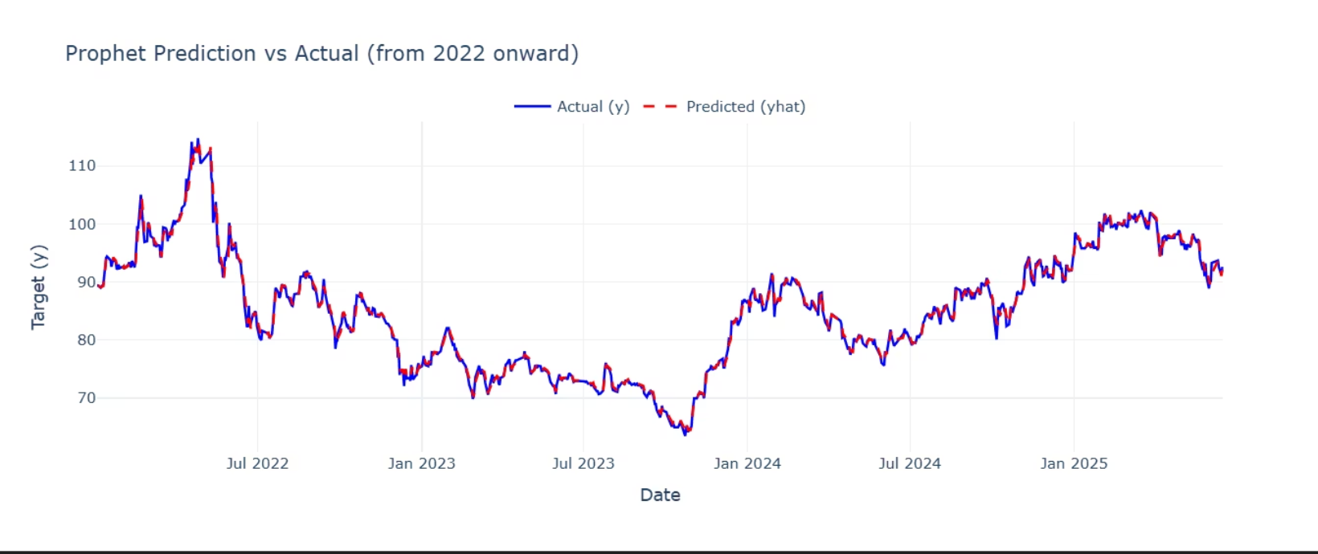
Prophet
Where magic happens!

Slide 10
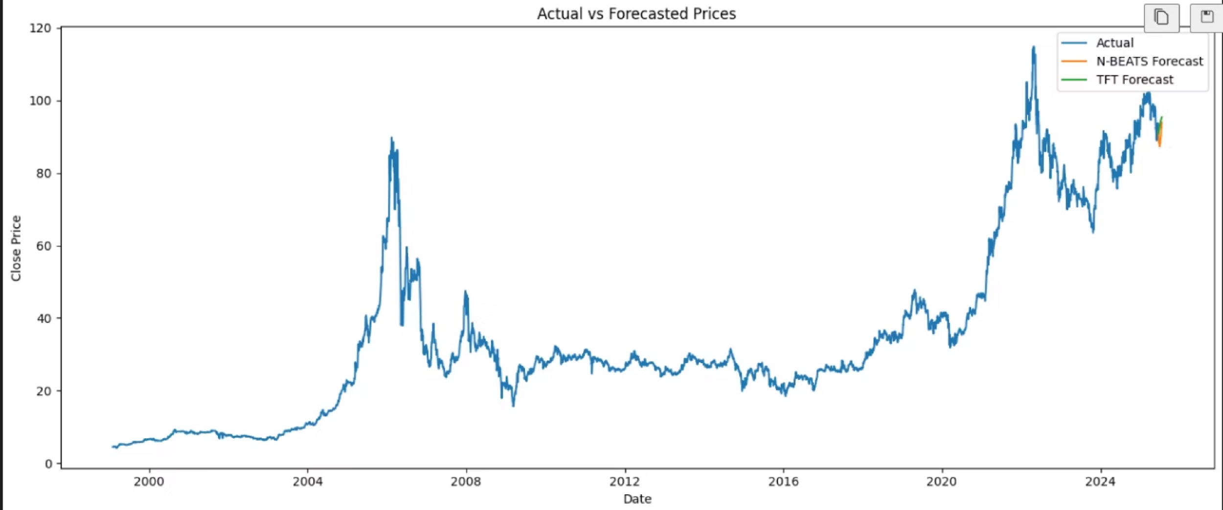
Innovative Technique
N-BEATS and TFT Forecast

Slide 11
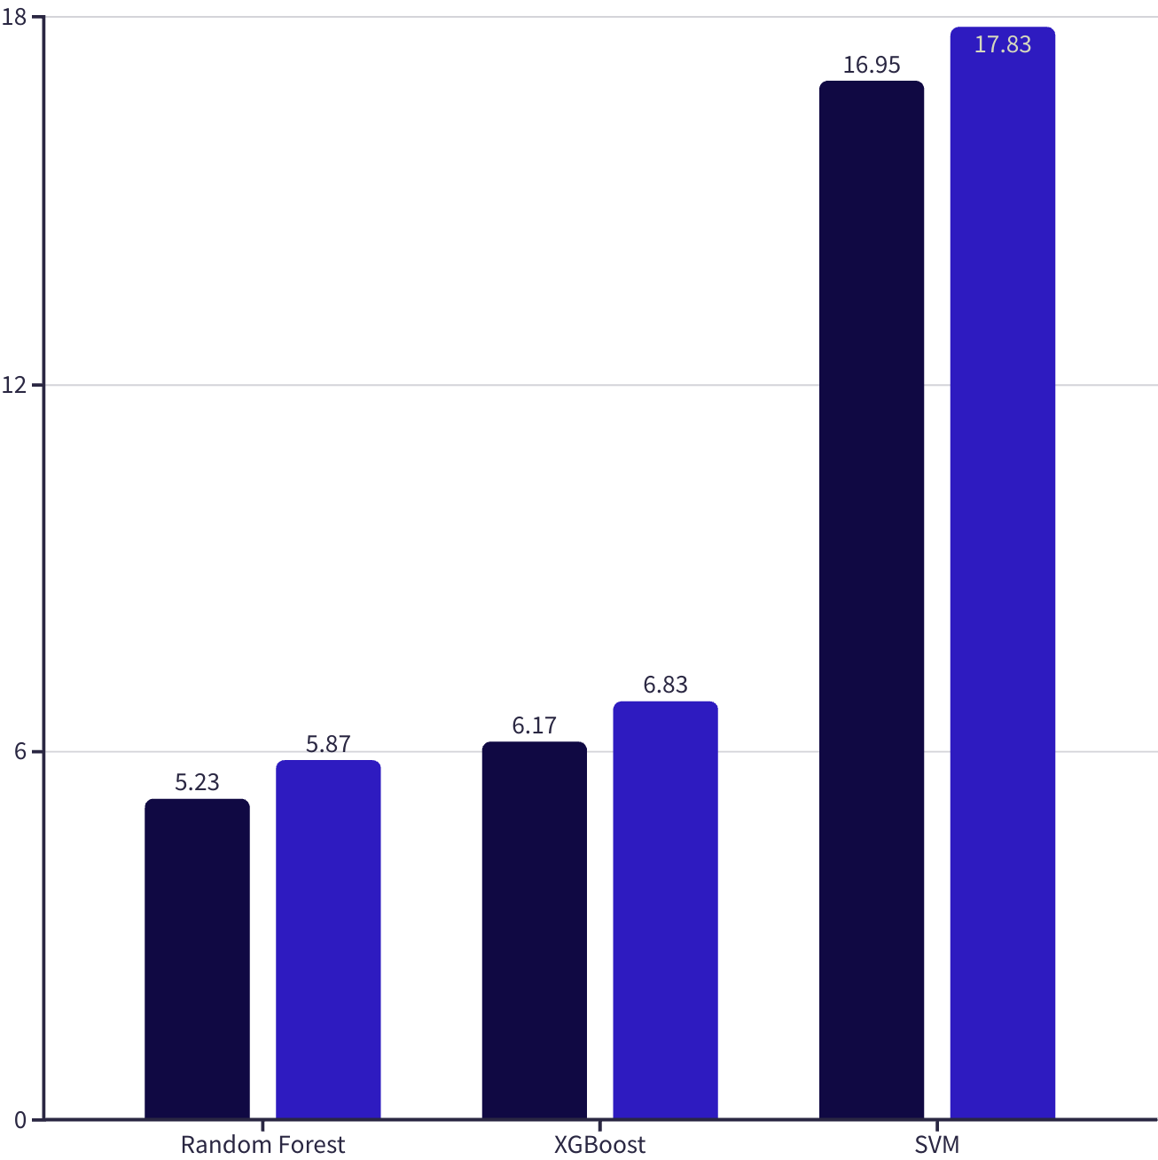

Machine Learning Models: Performance & Limitations
Performance Insights
Random Forest (MAE=5.23, RMSE=5.87) and XGBoost (MAE=6.17, RMSE=6.83) demonstrated decent performance. Support Vector Machines (SVM) showed very high errors, indicating poor fit for this dataset.
Challenges with R²
These models exhibited notably lower R² values, suggesting limitations in capturing variance. This is likely due to the nature of feature engineering for ML models compared to time series specific models.
MAE
RMSE

Slide 12
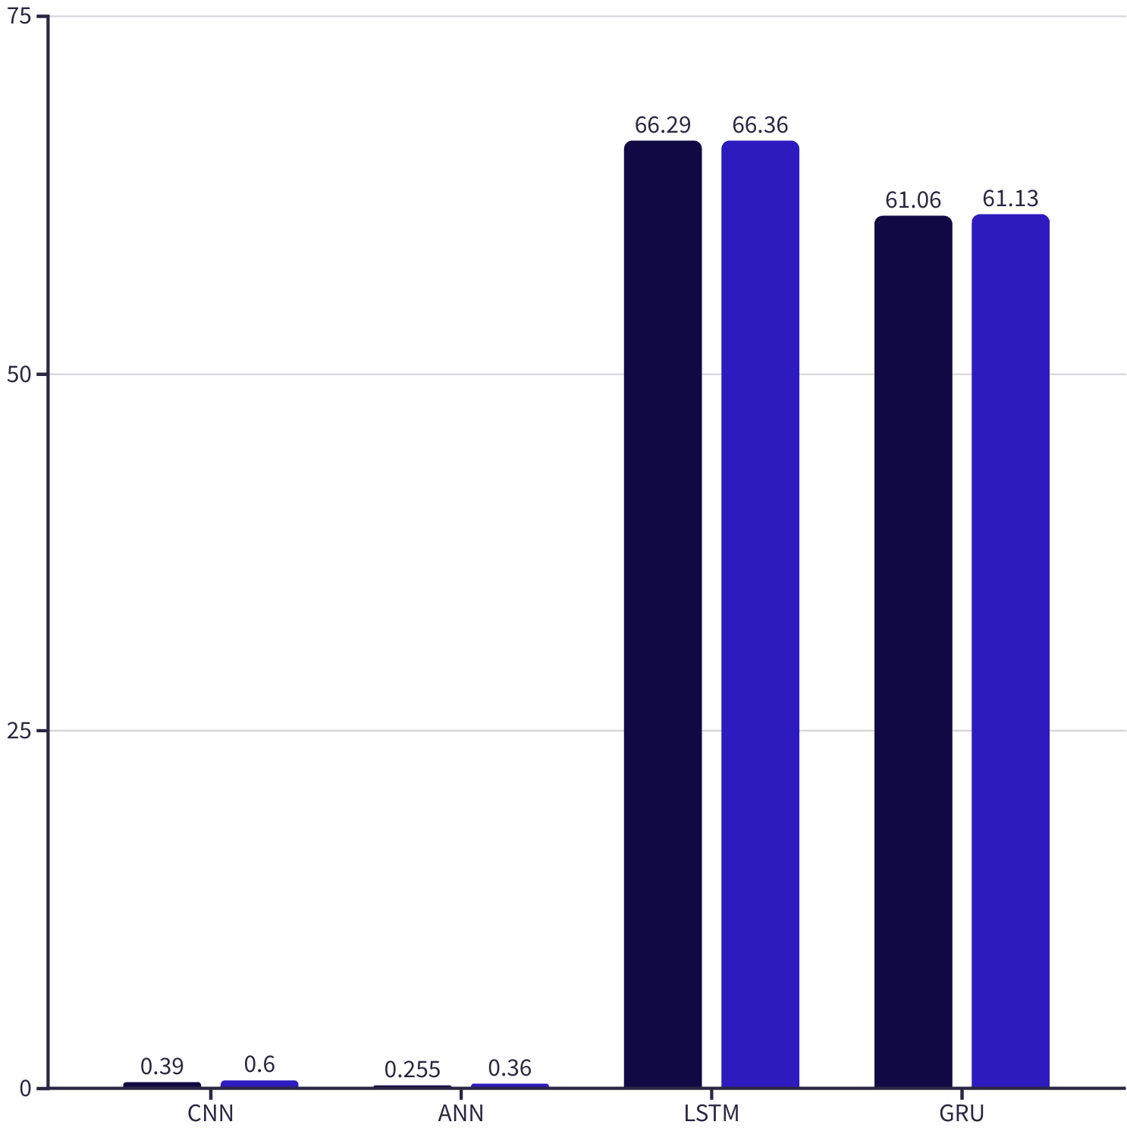
Deep Learning Models: Leading the Way in Accuracy
Top Performers: ANN & CNN
Artificial Neural Networks (ANN) and Convolutional Neural Networks (CNN)
emerged as top performers. ANN achieved an impressive MAE=0.26, RMSE=0.36, and R²=0.98. CNN followed closely with MAE=0.39, RMSE=0.61, and R²=0.96.
LSTM/GRU Underperformance
Surprisingly, LSTM and GRU models performed poorly (MAE and RMSE around 66). This is likely due to the stable feature patterns and the small input window size, which didn't fully leverage their sequential learning capabilities.
MAE
RMSE

Slide 13
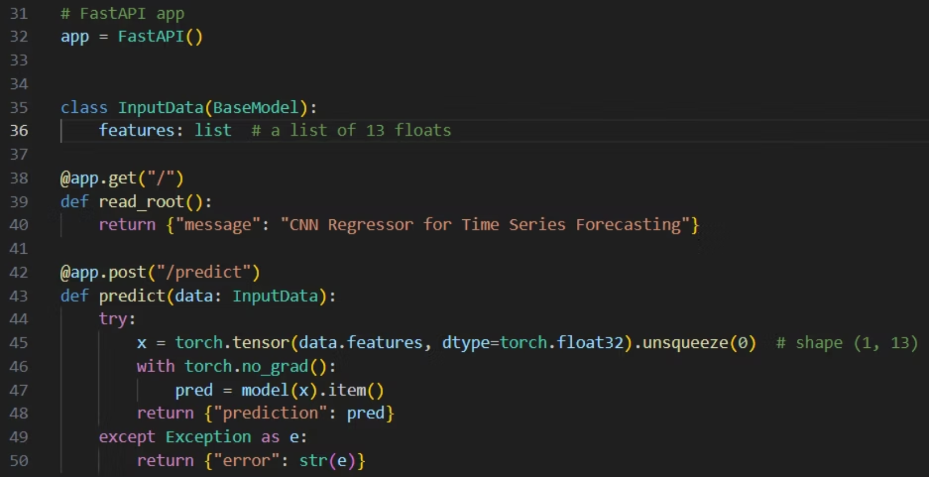
FastAPI Deployment: Real-time Forecasting
Model Preparation
{ "features": [1.1, 2.0, ..., 0.9] }
The trained CNN model, cnn_model.pt, was selected for deployment due to its robust performance and suitability for real-time inference.
FastAPI Integration
FastAPI was used to create a RESTful API with two key routes:
GET /: Returns the current status of the model service.
POST /predict: Accepts a JSON payload containing 13 features and returns the forecasted price.
Prediction Pipeline
The model is loaded using PyTorch, processes the input features, and returns predictions as a JSON response, enabling seamless integration with other applications.
{ "prediction": 2453.14 }

Slide 14
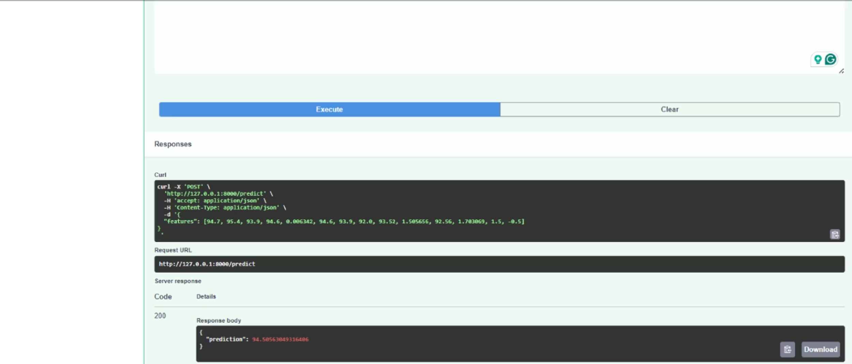
Deployment unit testing

Slide 15
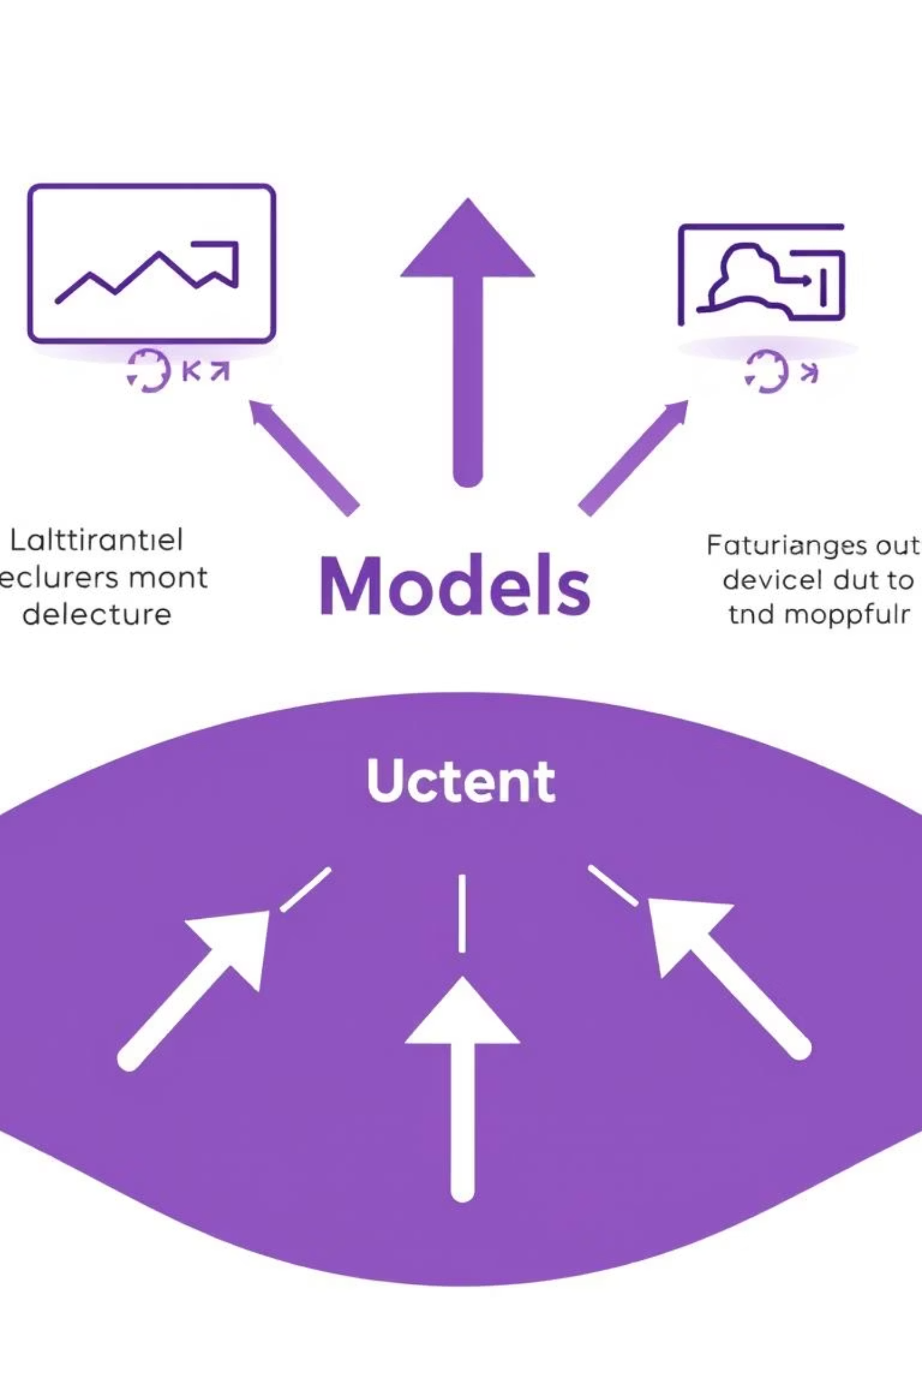
Final Insights & Future Work
Top Model Performers
SARIMAX: Best classical model, excelling with external dependencies.
Prophet: Most interpretable, strong for trend and seasonality.
ANN: Best overall accuracy, ideal for complex patterns.
CNN: Chosen for deployment due to robust performance.
Future Enhancements
Ensemble Modeling: Combine CNN and Prophet for enhanced accuracy.
Anomaly Detection: Implement alerts for unusual data points.
Streamlit Dashboard: Create an interactive dashboard for visualization.
Live Data Pipeline: Integrate with live data sources and databases.

